Slide 1

Online Shoppers’ PURCHASING Intention

Slide 2
Detecting Online Shoppers Purchasing Intention Gargee Singh Toronto Metropolitan University

Slide 3
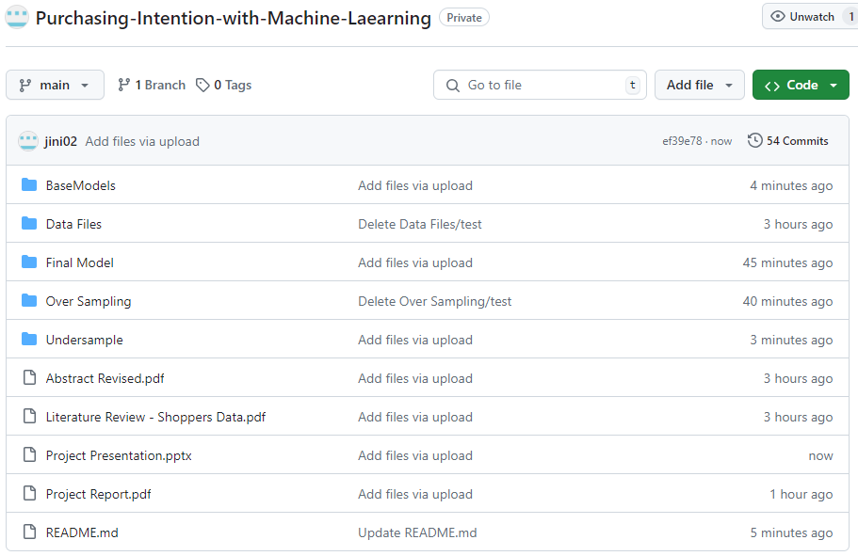
https://github.com/jini02/Purchasing-Intention-with-Machine-Laearning

Slide 4
Introduction
As online sales continue to expand and capture a larger share of the retail market, the ecommerce landscape is becoming increasingly competitive. Companies are intensifying their efforts to attract consumer attention and prevent customers from shifting to competitors
Machine learning plays a crucial role in these efforts, with companies utilizing streaming analytics and investing in predictive systems designed to enhance customer engagement.
In an online business the cost of a false negative , missing a client who could have made a purchase is a higher opportunity cost comparted to the extra attention on a shopper who would not make a purchase
Hence the proposed machine learning model will focus on recall and F2 score as compared to accuracy and precision

Slide 5
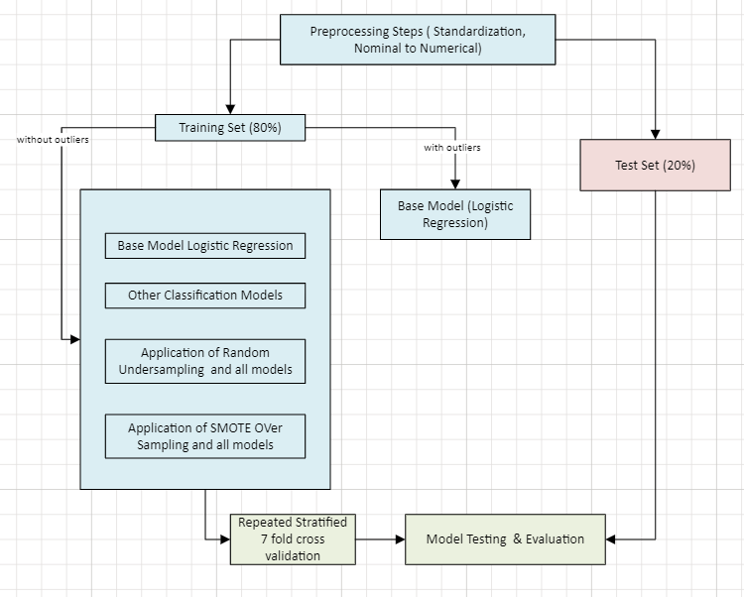
Workflow

Slide 6
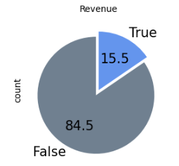
Highlights about the data set
Data Set has 10 numerical and 8 categorical variables
There are no null values in the data set
Out of the 12,330 instances ,12,205 (comparing all columns) instances were unique. Due to the nature of the data and the small volume (125 instances) these duplicates have not been removed.
The data set is imbalanced with only 15.5% of the instances belonging to the minority class

Slide 7
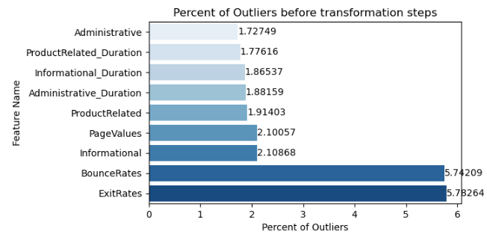
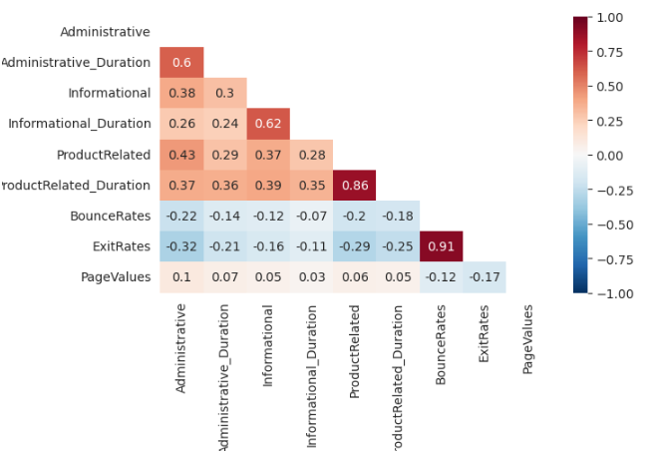
Highlights about the data set cont.
Some numerical columns have more outliers
Correlation between columns

Slide 8
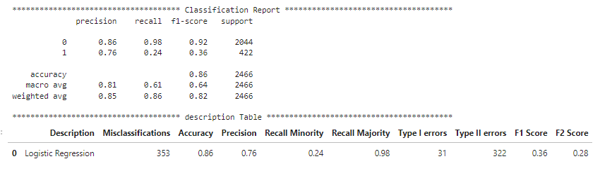
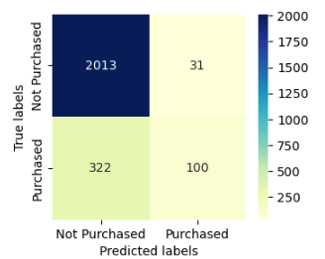
Base Model (Logistic Regression with outliers and correlation )
Evaluating the logistic regression model on the test data set ( 20% )
The model has decent accuracy to start with but poor recall for the minority class which is our focus since we want the model to be able to predict most of the minority class

Slide 9
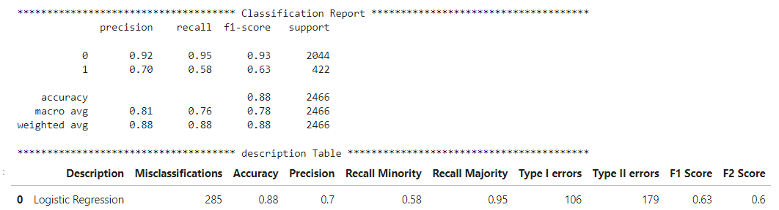
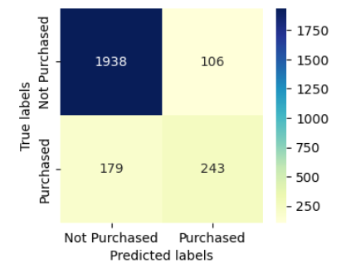
Base Model (Logistic Regression with normalized outliers and reduced correlation )
Evaluating the logistic regression model (normalized outliers and reduced correlation) on the test data set ( 20% )
These two steps have improved the recall value from the previous 0.24 to 0.58 , however they have also considerably increased the false positive cases from the previous 31 to 106 . Overall these two steps show improvement and we will move forward with this data

Slide 10
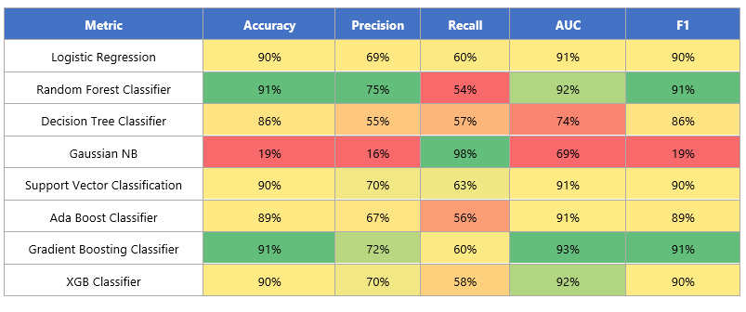
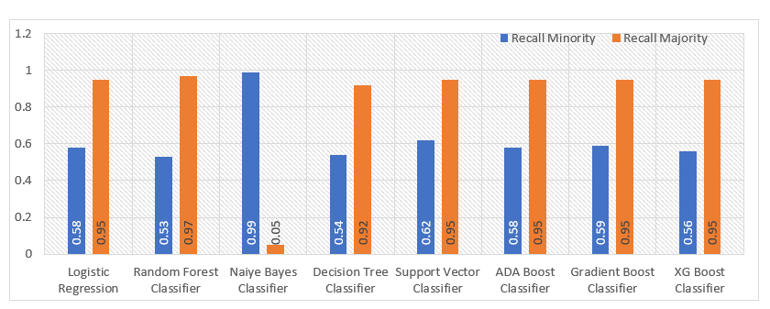
All models Cross Validation Score
Repeated Stratified 7 fold repeated 3 times
Random Forest Classifier seems to be the best performing model with some room for improvement with recall , followed by Gradient Boost Classifier
Naiye Bayes is the worst performing model as it is not even correctly predicting the majority class despite the imbalance
As expected due to the imbalance all models (except Naiye Bayes) show a very high majority recall and a weak minority recall.

Slide 11
Under sampling Results
Comparing the best Recall and F2 Score for models after under sampling to the score with imbalanced data
Most models show a significant improvement in the recall value after random under sampling which shows the balancing the data has improved the model performance. Random Forest classifiers has shown the highest gain in the recall value
Most models also show improved F2 score , driven by the improvement in the recall value

Slide 12
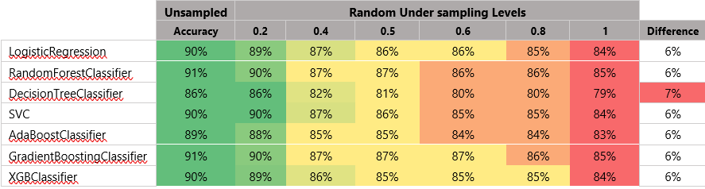
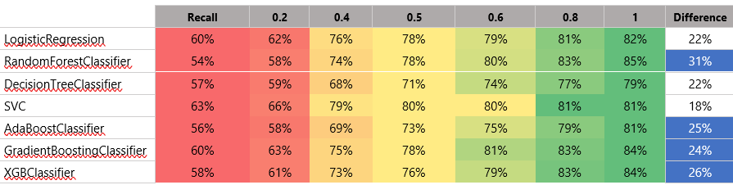
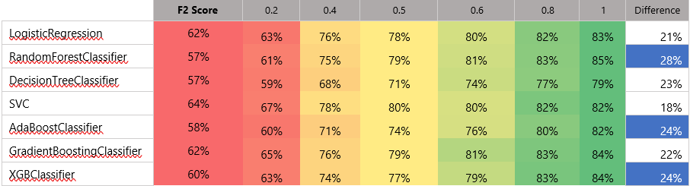
Under sampling Results contd Comparing Accuracy , Recall & F2 score at different under sampling ratios (0.2 to 1)
We see as the under sampling ratio increases and the data becomes more balanced the accuracy has dropped for all models but the recall value has gone up which would imply that as the models get better at reducing false negatives , potential false positives are going up
This may be due to loss of information due to under sampling
A ratio in between 0.7 to 0.8 might help balance this
F2 score along also shows improvement along with recall

Slide 13
Oversampling results
Comparing the best Recall and F2 Score for models after over sampling to the score with imbalanced data
Balancing the data set with Over sampling techniques (SMOTE ENN & BORDERLINE) has also shown substantial improvement in both recall and F2 Score

Slide 14
Oversampling results (contd)
Contrary to the under sampling results , accuracy does not suffer as much with oversampling . Along with improvement in recall and F2 score , accuracy has dropped only slightly which would mean that oversampling helps minimize false negative and does not substantially increase false positives

Slide 15
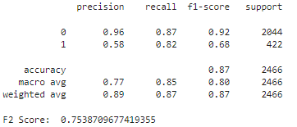

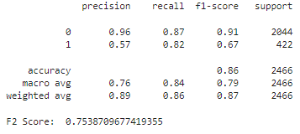
Final Model Evaluation – Under sampling
Random Forest Classifier at under sampling ratio of 0.77 was run as default and with hyper parameter tuning
We see that fine tuning the model for hyper parameters has not made any impact to the recall value and F2 score but impacts F1 score and accuracy
The tuned model shows lower F1 score and accuracy which would mean that the tuned model has slightly higher false positives, possibly due to over fitting
Between the two , recommendation would be to use the random forest classifier without fine tuning due a tie between recall and F1 score but higher accuracy and f1 for the default model

Slide 16
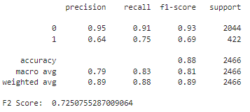

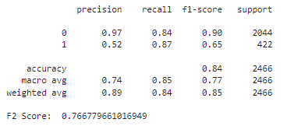
Final Model Evaluation – Over Sampling
Random Forest Classifier with BorderLine SMOTE
Random Forest (default) with over sampling technique has not resulted in a better result than under sampling , recall value of the majority class is higher but the recall for the minority class has dropped
After hyper parameter tuning with Grid Search we see some improvement in recall and F2 score however at the cost of accuracy and false positives going up
Between the two methods , recommendation would be random forest classifier with Border Line SMOTE to predict a customers’ purchasing intention .

Slide 17
Thank you

